Slide 1

Java Project Presentation
Project Title: DIU CampusCart
Presented By
1. Abdullah Al Noman (232-15-797)
2. Supan Roy (232-15-716)
3. Md. Shahinur Kabir Antor (232-15-159)
4. Nur Sayda (232-15-437)
5. Shakira Rahman Simi (232-15-723)

Slide 2
Outline
Objective
Working Procedure
Related Works
Project User Interface
Input Out Demo
Expected Outcomes
Conclusion
232-15-437

Slide 3
Objective
The primary goal of DIU CampusCart is to develop a secure and user-friendly online marketplace exclusively for DIU students residing in hostels or near the university.
Specific objectives include:
Providing a structured platform for buying and selling second-hand goods.
Ensuring authenticity by restricting access to DIU students only.
Minimizing fraud risks through an admin approval system.
Enhancing user experience with search, filtering, and product categorization.
232-15-437

Slide 4


Related Works
1. Bikroy.com
Popular Bangladeshi classified ads website.
Allows users to buy/sell products across categories.
Open to all users, lacks campus-specific targeting.
No academic email verification, so lacks trust in student-to-student trades.
2. Facebook Marketplace (Buy-Sell Groups)
Students often buy/sell items via FB groups or Marketplace.
No built-in verification system – anyone can join.
Hard to filter relevant posts & no proper category system.
Trust and safety concerns with strangers.
232-15-159

Slide 5
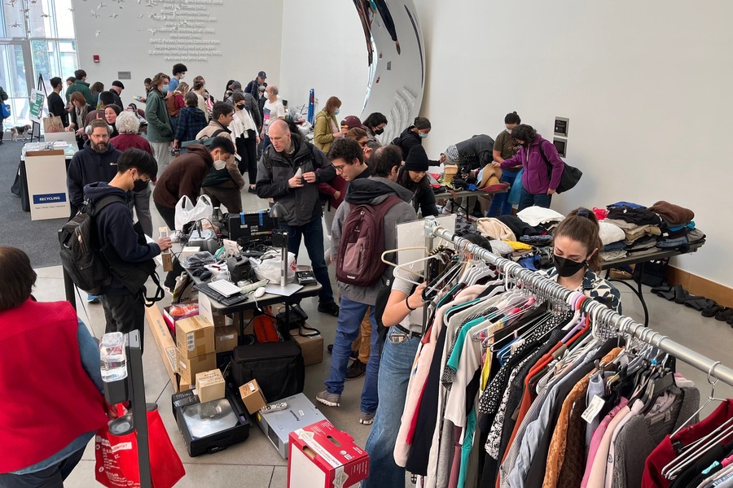
Related Works
📚 3. Campus Classified Portals (e.g., MIT Reuse)
Internal marketplaces for students.
Verified access using university email.
Focus on trust, simplicity, and academic community only.
[Image Courtesy: MIT News ]
232-15-159

Slide 6
Working Procedure
🔄 1. User Registration & Verification
New users register using DIU edu email.
A verification link is sent to their email.
After verification, users can log in securely.
👤 2. Login & Authentication
Users log in with email and password.
Session-based login system is used to maintain user authentication.
232-15-716

Slide 7
Working Procedure
📦 3. Product Listing
Verified users can:
Upload product details (name, price, category).
Add image and description.
The ProductController initiates the saving process. The ProductService passes it along. The ProductRepository is where the actual saving to the H2 database happens.
🔍 4. Browsing & Searching
Products displayed by:
Category (Furniture, Electronics, etc.).
Implemented using Product API with JSON responses.
232-15-716

Slide 8
Working Procedure
🛒 5. Buying & Contact
Interested users choose product
Product owner’s contact details are sent to buyer upon request acceptance.
Cash on Delivery (COD) is the payment method.
After seller confirms the sale, an invoice is automatically emailed to both the buyer and seller.
🔐 6. Admin Management
Admin can:
View all users & products.
Remove inappropriate items.
Delete unwanted user.
Ensure system integrity.
💾 7. Database
All data is stored in H2 persistent database
Spring Boot handles backend logic.
232-15-716

Slide 9
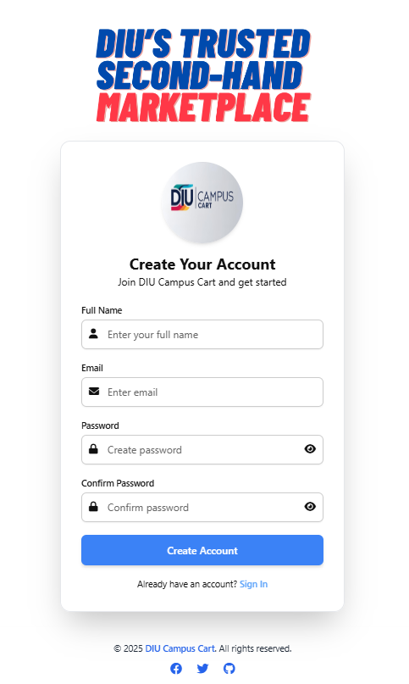
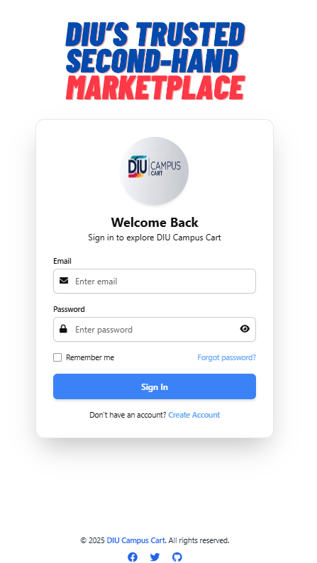
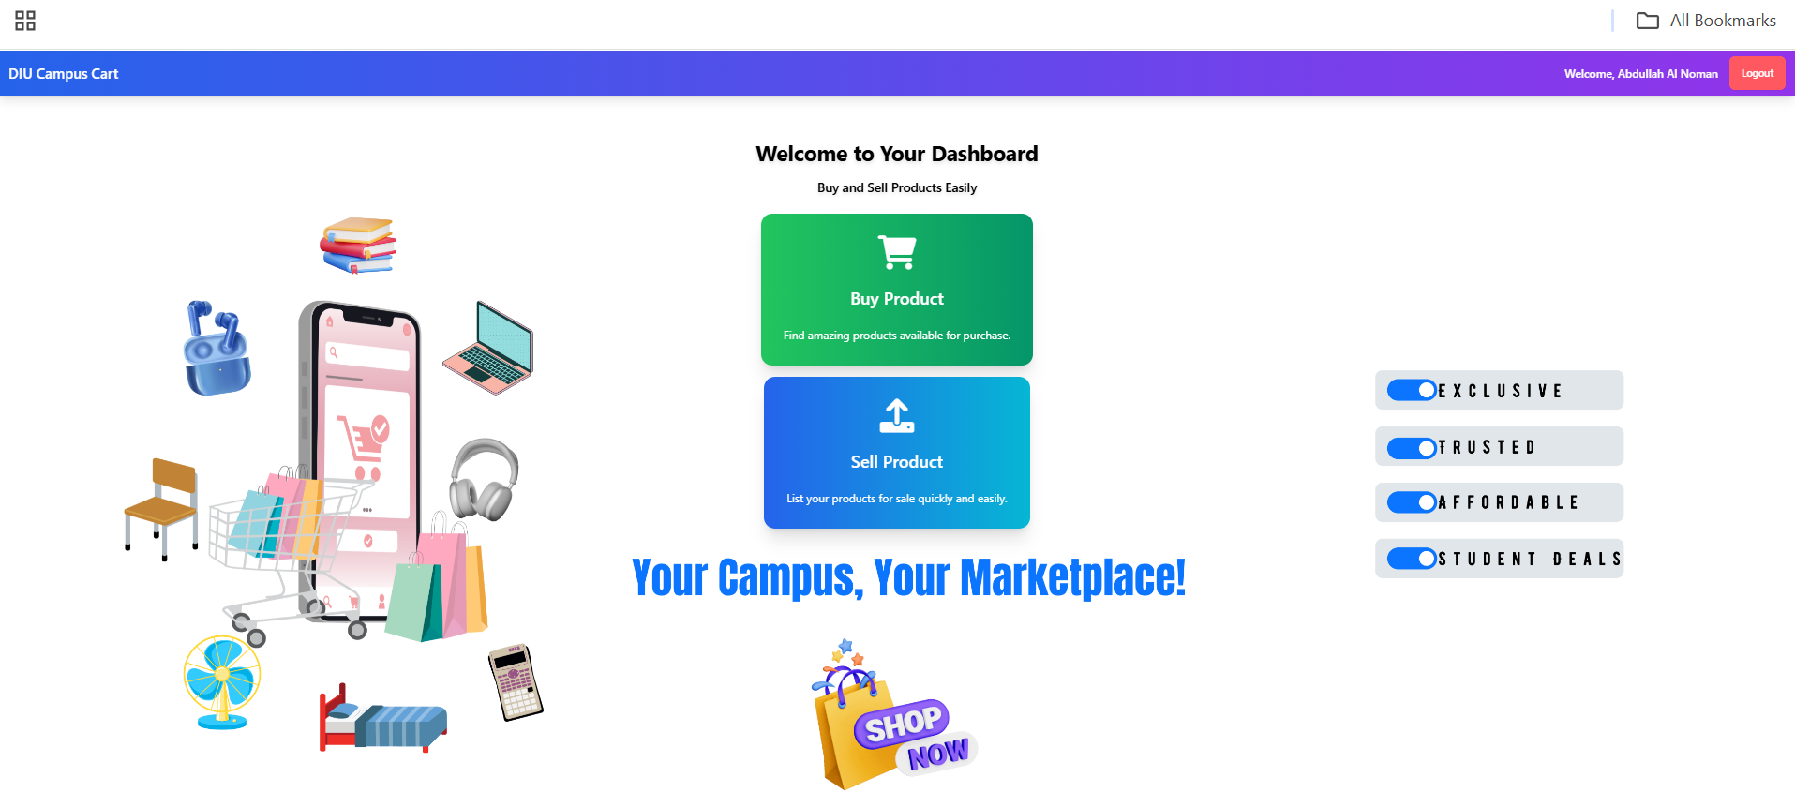
Project User Interface
1. Create Account
2. Sign In
3. User Dashboard
232-15-716

Slide 10
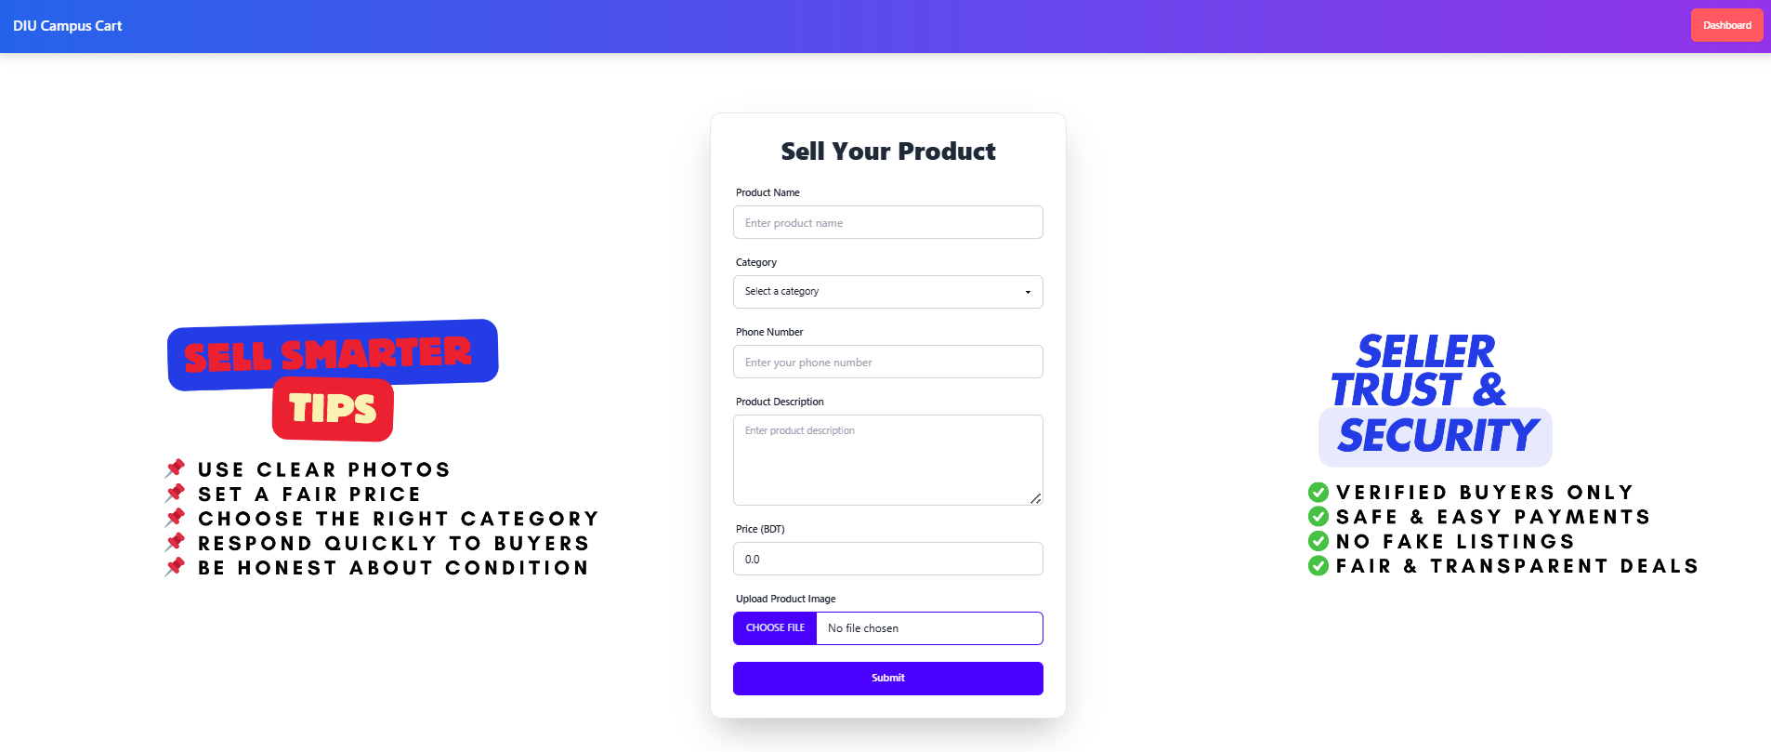
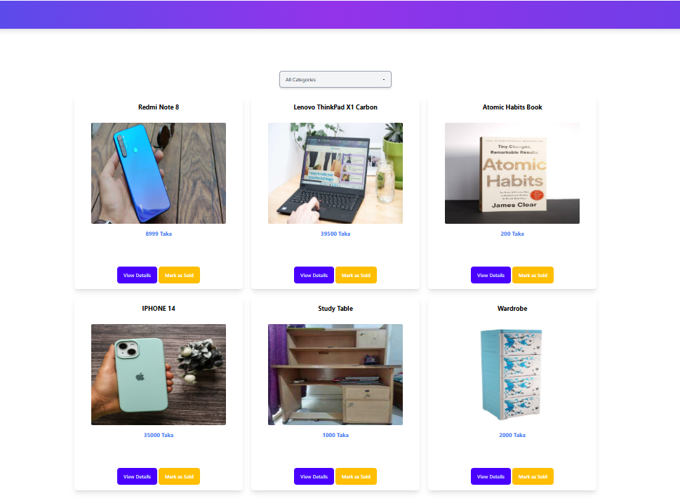
Project User Interface
4. Sell Product
5. Buy Product
232-15-716

Slide 11
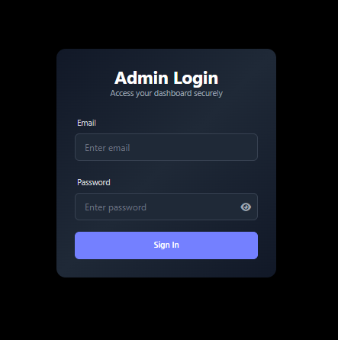
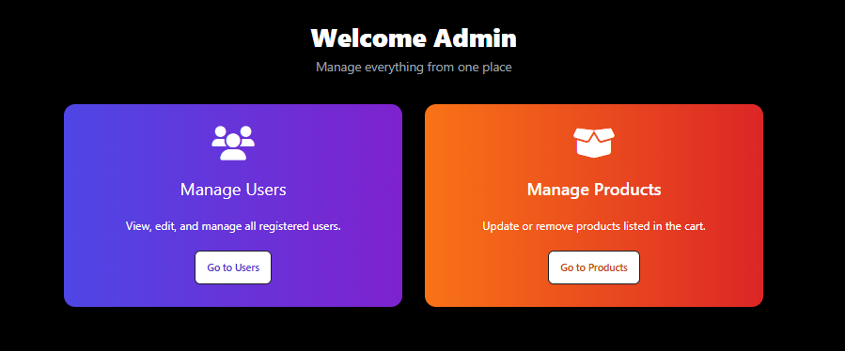
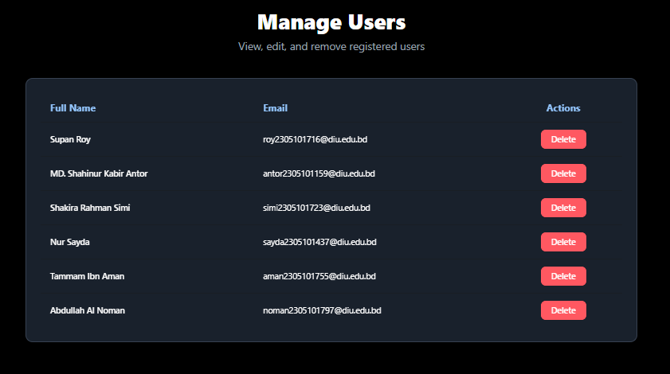
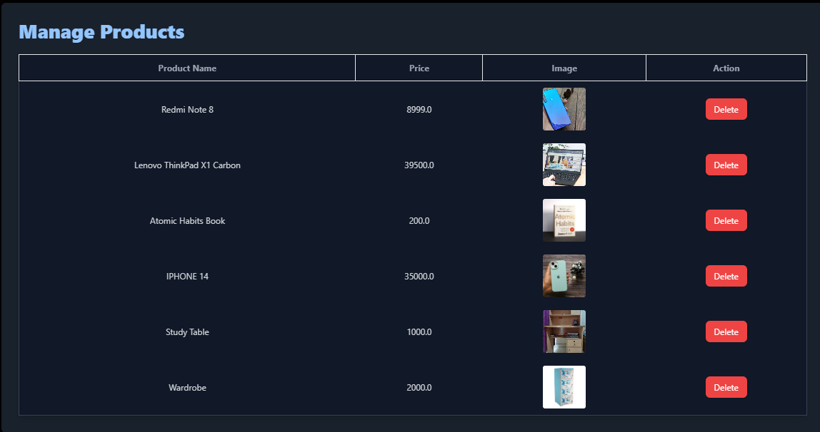
Project User Interface
6. Admin Login
7. Admin Dashboard
8. Manage Products
9. Manage Users
232-15-716

Slide 12
Input Output Demo
Click Here to show the demo video
Alternative Link 1
Alternative Link 2
232-15-797

Slide 13
Expected Outcomes
🎯 Expected Outcomes
Verified Access:
Only DIU emails (@diu.edu.bd) can sign up — ensuring a safe campus environment.
Easy Buy & Sell:
Students can post products with images, price, and details.
Smart Browsing:
Category-based filtering for quick product discovery.
Admin Control:
Admins can manage users and products to keep the platform clean.
Real Impact:
Solves a genuine problem for DIU students, promoting sustainability.
232-15-723

Slide 14
Conclusion
DIU CampusCart offers a safe, DIU-only platform for students to buy and sell second-hand items. It encourages smart savings, reusability, and community support within the campus. With verified email login, a clean UI, and category-wise browsing, the platform ensures trust and ease. It reduces dependency on external marketplaces and helps students access resources faster.
Overall, it’s a practical solution designed by students, for students — to trade, connect, and support each other.
232-15-723

Slide 15
Thank You

